Slide 1
1 | Workflow
2 | Collate
3 | Batch
4 | Zone Picking
5 | Pick Eligibilities
6 | Picking Cart
7 | Outbound Management
8 | Order Pool
9 | Process Path
10 | Rebatch Station Type
11 | Rebatch Station
12 | Rebin Station Type
13 | Rebin Station
14 | Rebin Wall
15 | Pack Station Type
16 | Pack Station
17 | Box Configure
18 | Pick Path

Slide 2
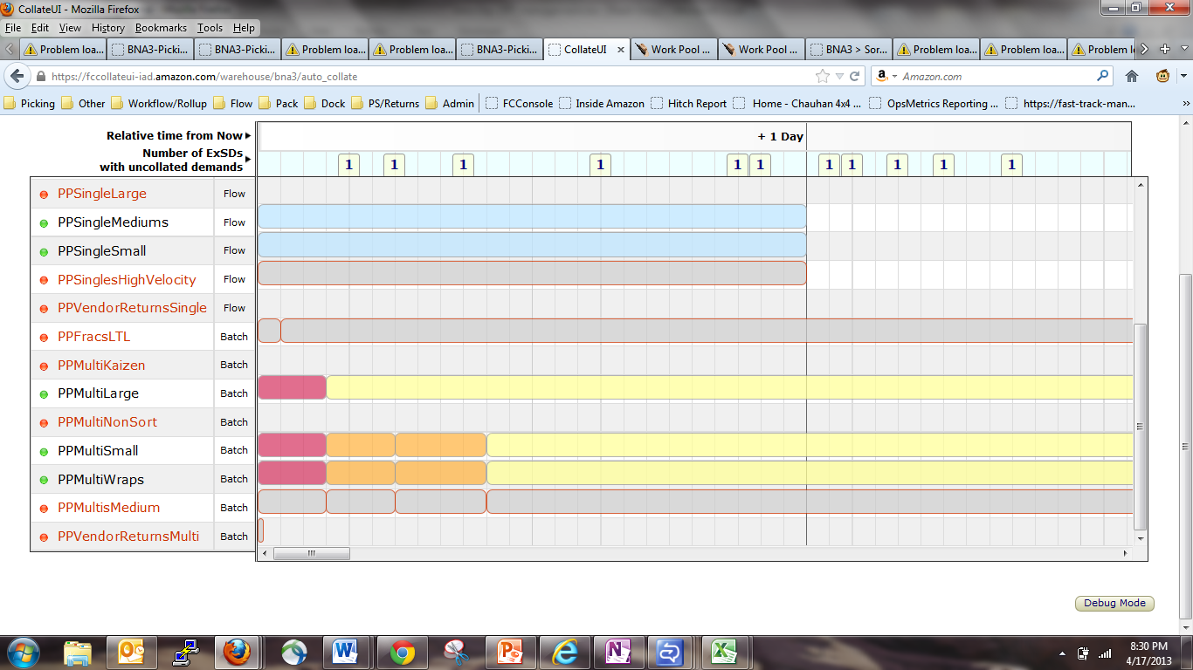
2-Collate
主界面
Reprint Shipment | Reprint Invoice | Add Collate Profile
1
1
2
1
1
2
08 | 09 | 10 | 11 | 12 | 13 | 14 | 15 | 16 | 17 | 18 | 19 | 20 | 21 | 22 | 23 | 00 | 01 | 02 | 03 | 04 | 05 | 06 | 07 | 08 | 09 | 10 | 11 | 12 | 13 | 14 | 15 | 16 | 17 | 18 | 19 | 20 | 21 | 22 | 23 | 00 | 01

Slide 3
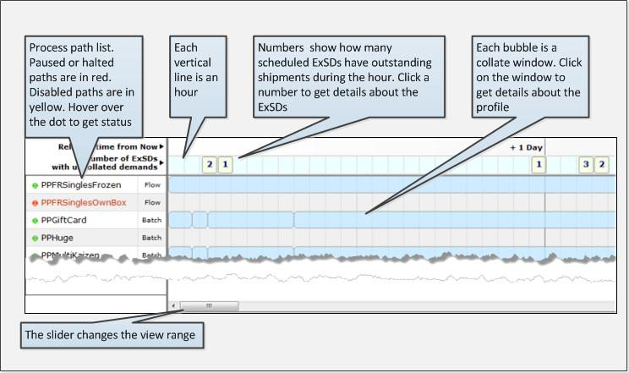
2-Collate
How CollateUI Works

Slide 4
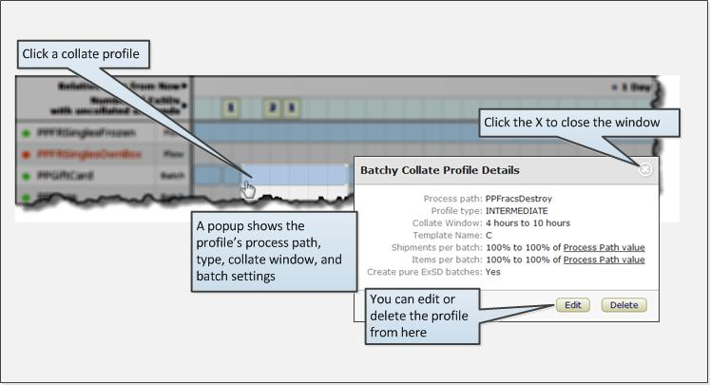
2-Collate
Profile Details

Slide 5
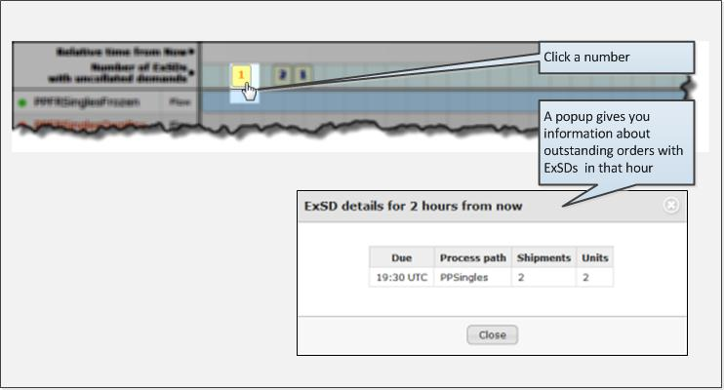
2-Collate
CPT Details

Slide 6
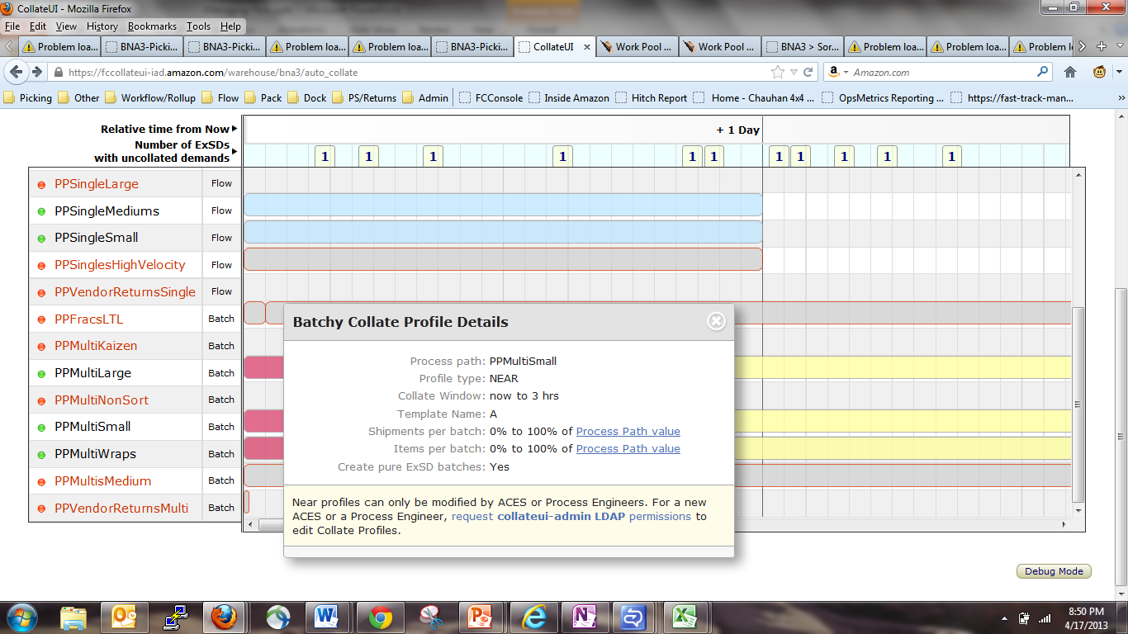
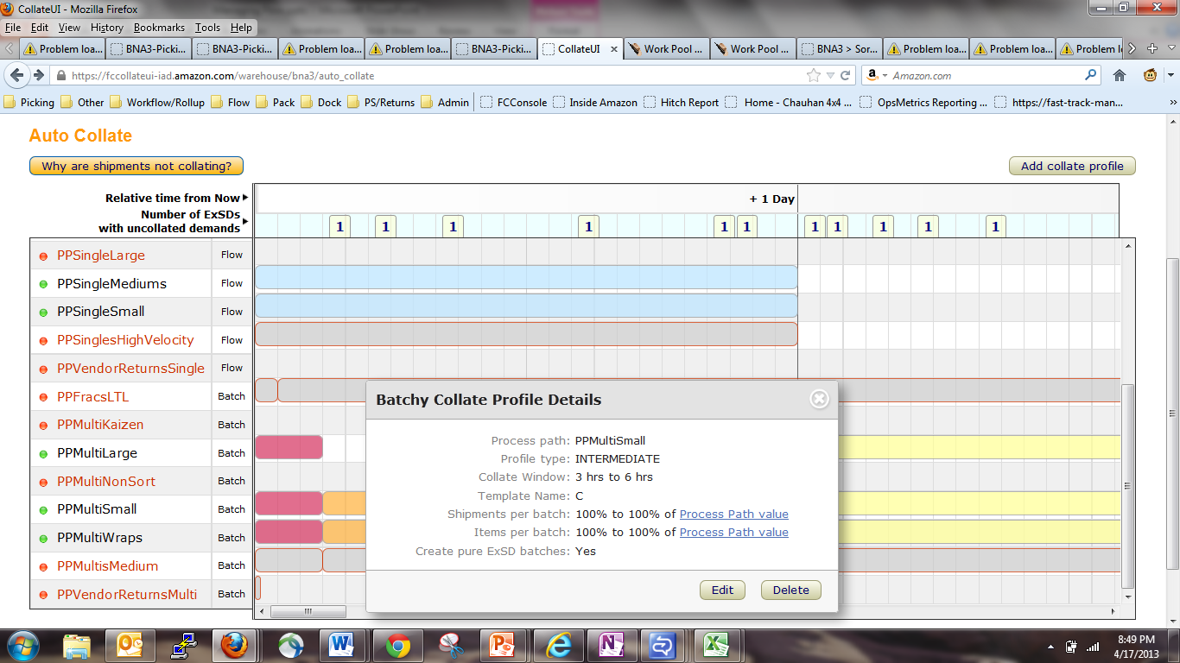
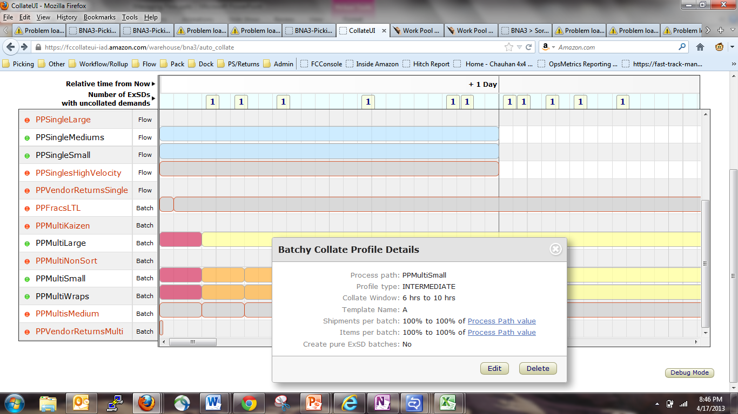
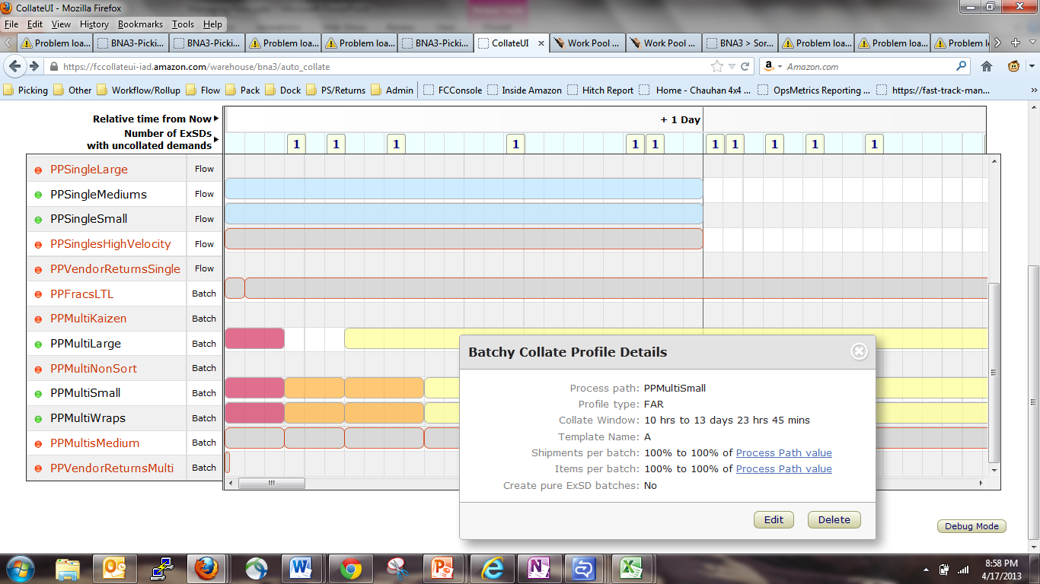
Collate演示

Slide 7
2-Collate
Reprint Shipment
See Collate Profile
Reprint Shipment | Reprint Invoice | Add Collate Profile
1
1
2
1
1
2
08 | 09 | 10 | 11 | 12 | 13 | 14 | 15 | 16 | 17 | 18 | 19 | 20 | 21 | 22 | 23 | 00 | 01 | 02 | 03 | 04 | 05 | 06 | 07 | 08 | 09 | 10 | 11 | 12 | 13 | 14 | 15 | 16 | 17 | 18 | 19 | 20 | 21 | 22 | 23 | 00 | 01
Reprint Shipment
Please Enter The Shipment ID
Please Select the Printer ID
确认
取消

Slide 8
2-Collate
Reprint Invoice
See Collate Profile
Reprint Shipment | Reprint Invoice | Add Collate Profile
1
1
2
1
1
2
08 | 09 | 10 | 11 | 12 | 13 | 14 | 15 | 16 | 17 | 18 | 19 | 20 | 21 | 22 | 23 | 00 | 01 | 02 | 03 | 04 | 05 | 06 | 07 | 08 | 09 | 10 | 11 | 12 | 13 | 14 | 15 | 16 | 17 | 18 | 19 | 20 | 21 | 22 | 23 | 00 | 01
Reprint Invoice
Please Enter The Shipment ID
Please Select the Printer ID
确认
取消

Slide 9
2-Collate
Reprint Invoice
See Collate Profile
Reprint Shipment | Reprint Invoice | Add Collate Profile
1
1
2
1
1
2
08 | 09 | 10 | 11 | 12 | 13 | 14 | 15 | 16 | 17 | 18 | 19 | 20 | 21 | 22 | 23 | 00 | 01 | 02 | 03 | 04 | 05 | 06 | 07 | 08 | 09 | 10 | 11 | 12 | 13 | 14 | 15 | 16 | 17 | 18 | 19 | 20 | 21 | 22 | 23 | 00 | 01
Add Collate Profile
Template Name
A
Min Item
100%
Max Item
100%
Min Shipment
100%
Max Shipment
100%
Create Pure ExSD Batch
No
确认
取消

Slide 10
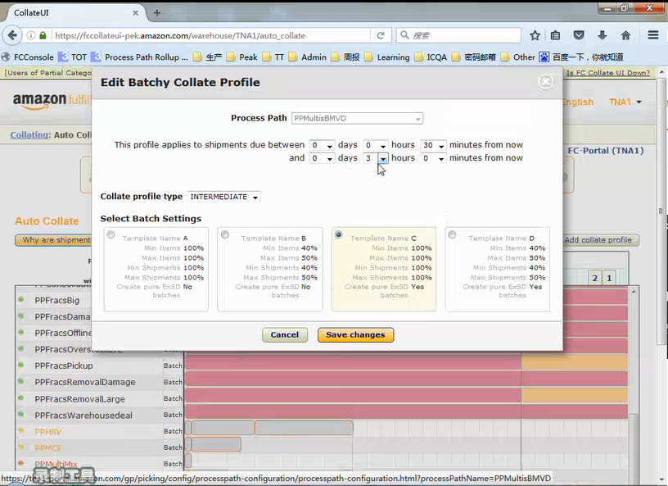
2-Collate
Reprint Invoice

Slide 11
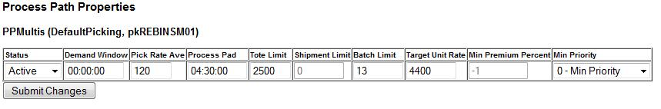
2-Collate
Reprint Invoice
See Collate Profile
Reprint Shipment | Reprint Invoice | Add Collate Profile
1
1
2
1
1
2
PPMultiLarge
08 | 09 | 10 | 11 | 12 | 13 | 14 | 15 | 16 | 17 | 18 | 19 | 20 | 21 | 22 | 23 | 00 | 01 | 02 | 03 | 04 | 05 | 06 | 07 | 08 | 09 | 10 | 11 | 12 | 13 | 14 | 15 | 16 | 17 | 18 | 19 | 20 | 21 | 22 | 23 | 00 | 01

Slide 12
2-Collate
PPMultiLarge
1. Status:
Active: Batches会被collated并且按照PP的其他设定被安排拣货
Collate Disabled: 停止collating, 但所有已经collate完成的批次会被安排完成拣货. 如果仅仅collate需要被暂停，这个设定是建议值
Paused: 同时停止拣货与新批次生成. 现阶段在PP里的拣货人员会完成剩余在拣货枪里的货品然后被系统分配到其他PP里. 直到PP状态切换成Active或Collate Disabled，该PP里不会再有新的拣货行为生成
2. Demand Window
zone picking中一个批次第一个被捡货品与最后一个被捡货品之间期望时间差. 如果一个现有批次接近Demand Window设定的时间，它所剩余的货品会被给予优先权
3. Pick Rate Average – 在此PP内，一个拣货员工一小时之内预计的平均拣货量
4. Process pad是系统用来决定pick need-by time, 而pick need-by time又用来决定货品为了满足在CPT前拣完一定要开始拣货的时间，Process pad应该大致接近一个订单在FC里走完所有工序的时间总和.，最重要和需要理解的设定之一
Normal Picking: PNB（Pick Need-by Time）之前、Late: PNB之后0-30分钟、Really Late: PNB30分钟之后且CPT2.5小时之外、Really Really Late: CPT2.5小时之内
5. Tote Limit – 任意时刻系统中的允许最大数目的totes数, Tote limit可以设定成去反映传送带的运送能力以控制整个传送系统的流量,如果设定成0代表传送能力是无限的. , FC可以改变这个值如果下游过载或量太少,帮助保持控制物理的流量并且减少回转率
6. Batch Limits：任意时刻系统允许同时打开批次的最大数目，任一批次从它第一个货品被拣直到最后一个货品被拣完都会记入Batch Limits
7.Target Unit Rate –每个小时计划系统在这条PP里处理的货品数量，TUR应该和下游的处理能力相对应，TUR应该随时被更改如果需要处理的总量或班次整体产出有变化，TUR/PRA的比值大致反映了会被分配到PP中的员工数目。但是，实际会被分配的员工数目还依赖于是否在追逐模式和其他因数
8. Min Premium Percent – 制定一个最小的百分比以优先预留TUR给一定的数量的premium订单(已无效)
9. Minimum Priority – 按照货品的运输方式设定最低优先级别
这个设定只需要去改变如果班次想按照CPT顺序优先处理高运输级别的订单

Slide 13
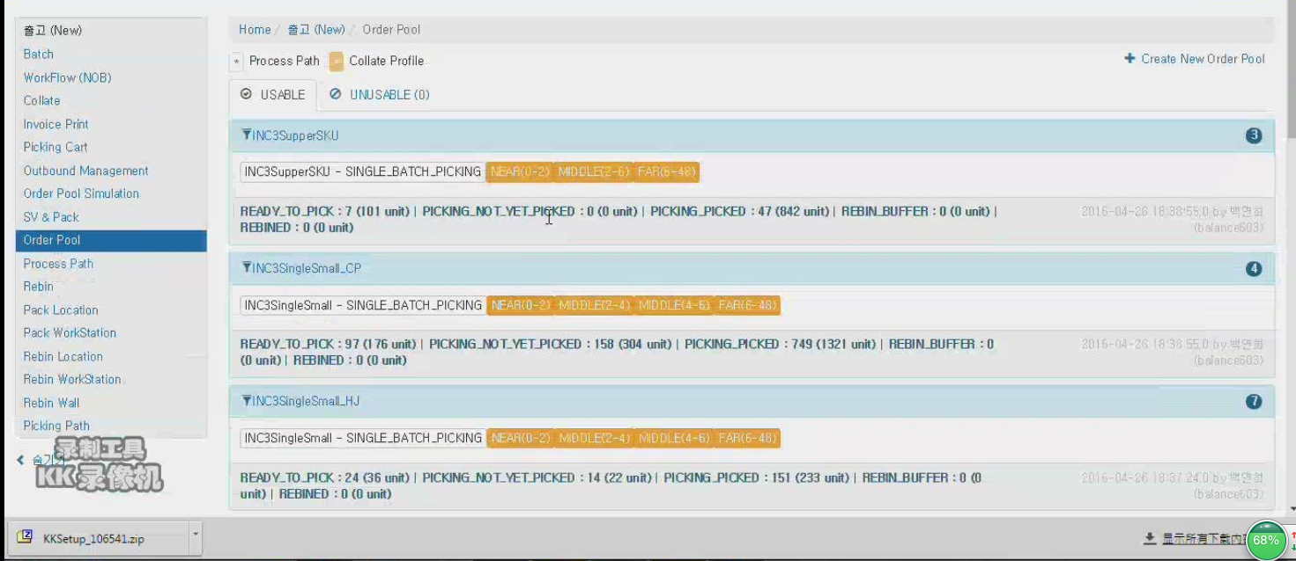
8-Order Pool

Slide 14
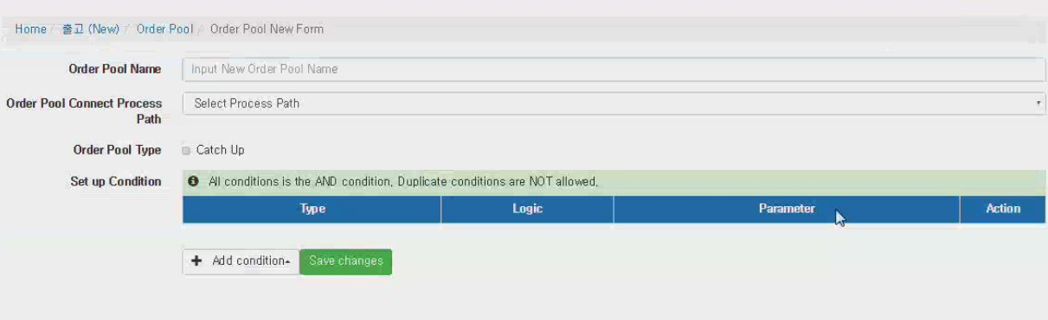
8-Create a New Order Pool-1

Slide 15
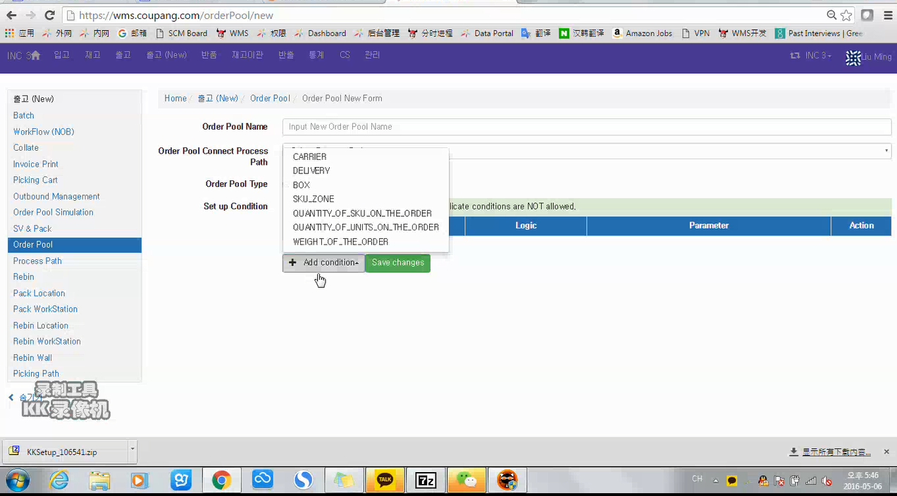
8-Create a New Order Pool-2

Slide 16
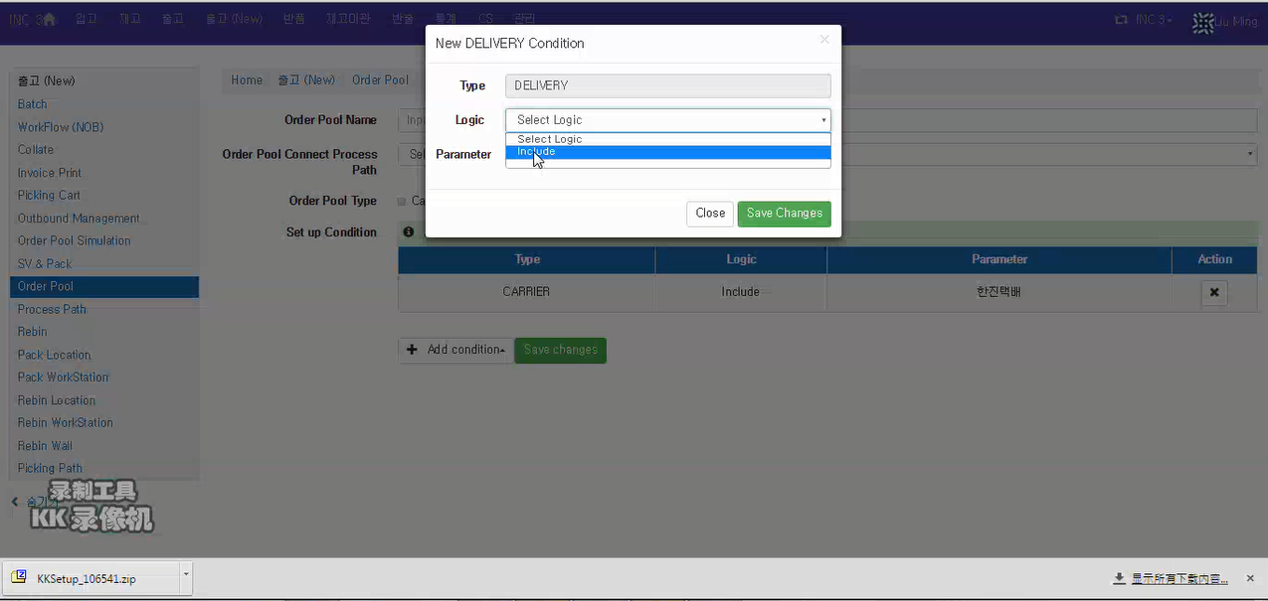
8-Create a New Order Pool-3

Slide 17
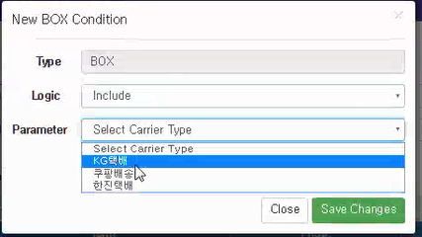
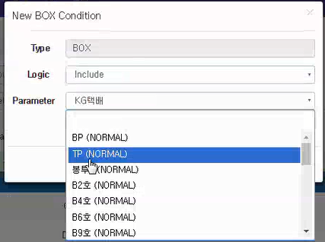
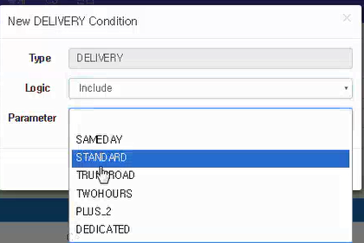
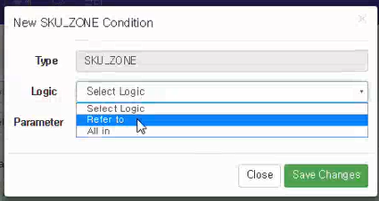
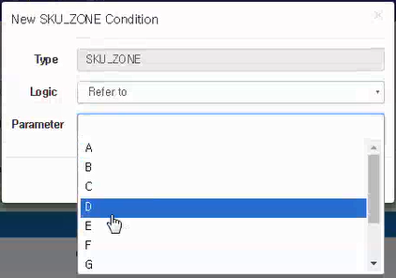
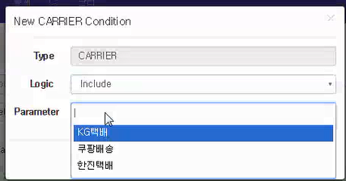
8-Create a New Order Pool-4

Slide 18
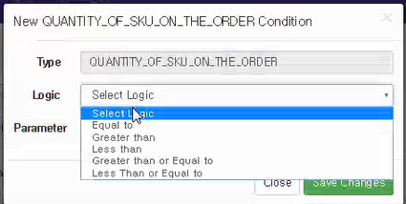
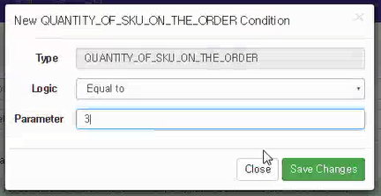
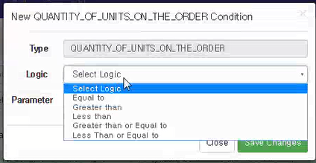
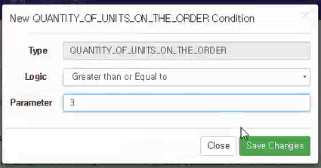
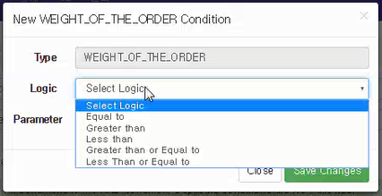
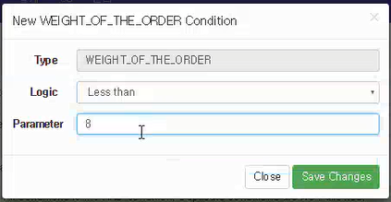
8-Create a New Order Pool-5

Slide 19
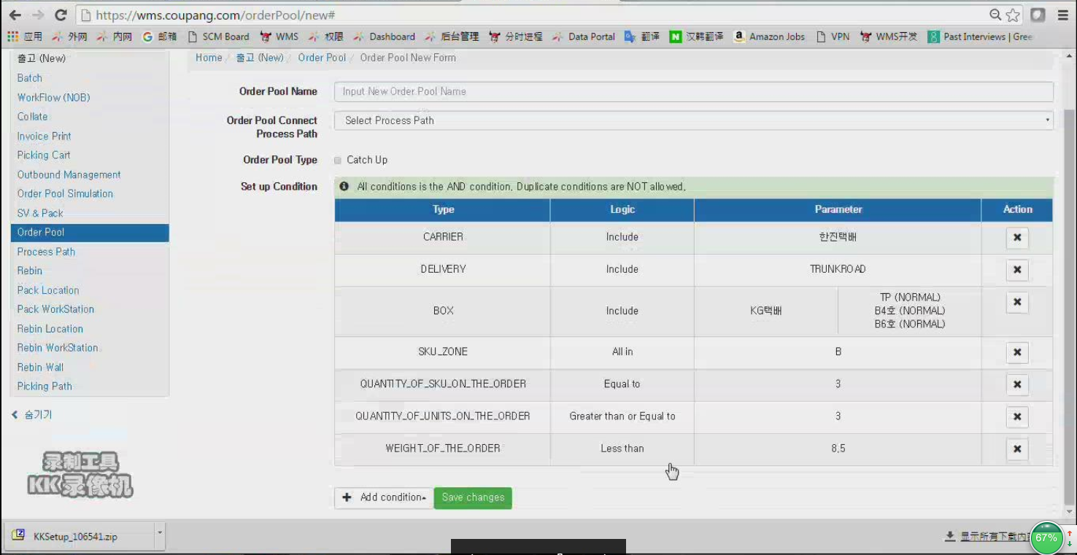
8-Create a New Order Pool-6

Slide 20
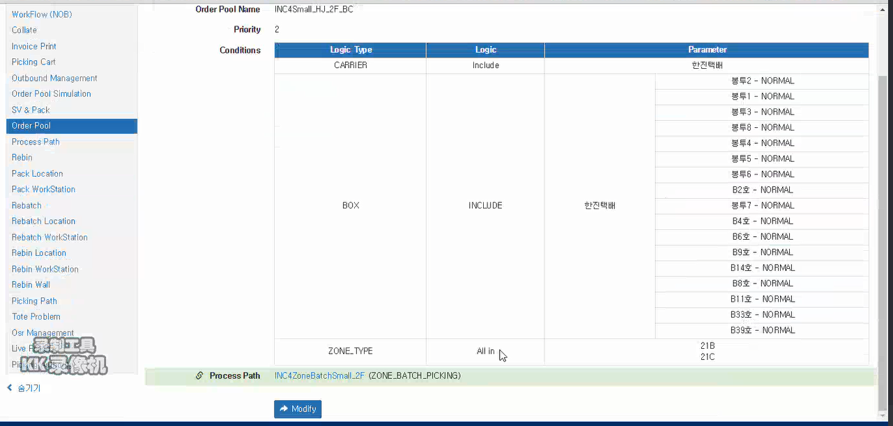
8-Order Pool

Slide 21
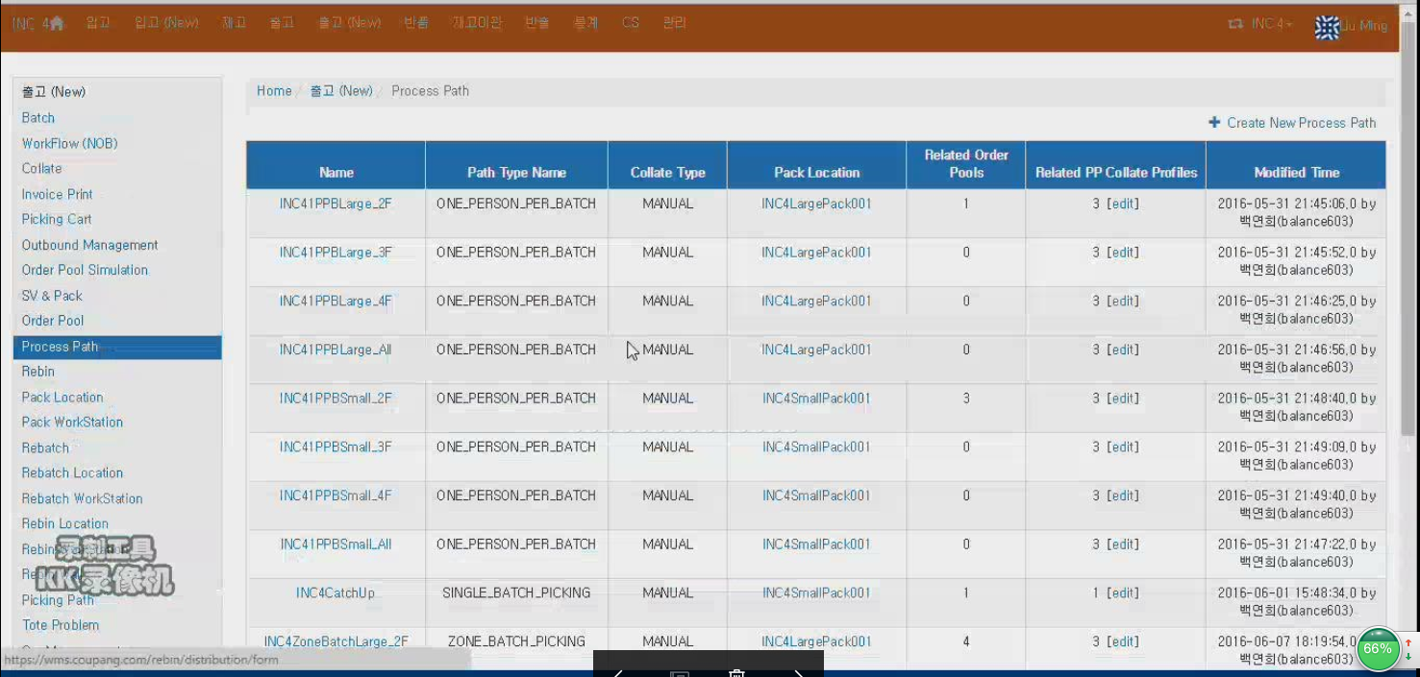
9-Process Path
+ Total Setting

Slide 22
9-Process Path-Total Setting
Total Setting
Scan Bin First
Weight Limit(Kg)
Color-Based Bin Picking
Color-Based Item Picking
Idle Timeout In Seconds
Yes
No
Yes
No
Yes
No

Slide 23
9-Process Path-Create New Process Path
+ Total Setting

Slide 24
9-Process Path-Create New Process Path
Process Path Base Information
Process Path Name
Process Path Type
Process Path No.
Process Path Specific Settings
Pick Eligibility
Shorted Picks
Pick reject Forced
Reject Reasons
shipments Per Batch | Min
 | Max
Item Per Batch | Min
 | Max
Collate Type
Auto Collate Document
Allowed Container Type
Pick Web UI Exclusive Configuration
Labor Unit class | （备注：在Function Rollup显示名称)
Dimension-Base Tote Fill Out
One Item Per Tote
Require New Tote On Pick Area Change
Tote Rescan
Location Configuration
Rebatch Location
Rebin Location | （下拉选项：Rebin Station Type）
Pack Location | （下拉选项：Pack Station Type）
Total Setting
Scan Bin First
Weight Limit（Kg）
Color-Based Bin Picking
Color-Based Item Picking
Idle Timeout In Seconds
Hot Pick
Back To Process
Yes
No
Auto
Manual
Batch Cover
Face Label
Shipment Detail
Tote
Cart
Pallet
Yes
No
Yes
No
Yes
No
Yes
No
Single
OSR
Rebatch
None
Yes
No
Yes
No
Yes
No

